Slide 1


Churn
Analysis

Slide 2

Project Recap
Project objective
Data Collection & Preparation
Model Selection & Evaluation
Feature Importance

Slide 3


Insights
10000
5151
2037
Active Members
Total Entry
Churn

Slide 4

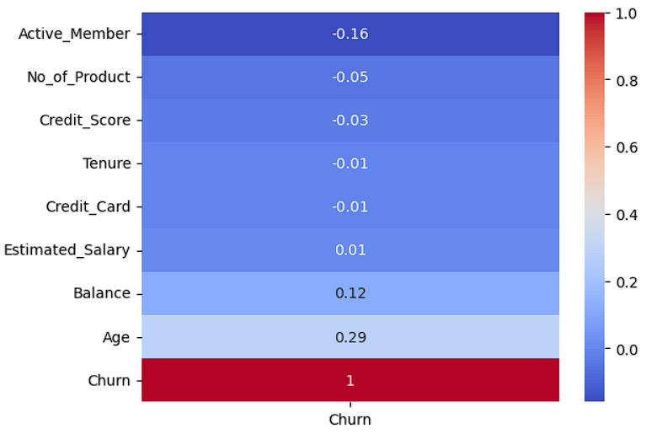
Correlation Matrix

Slide 5
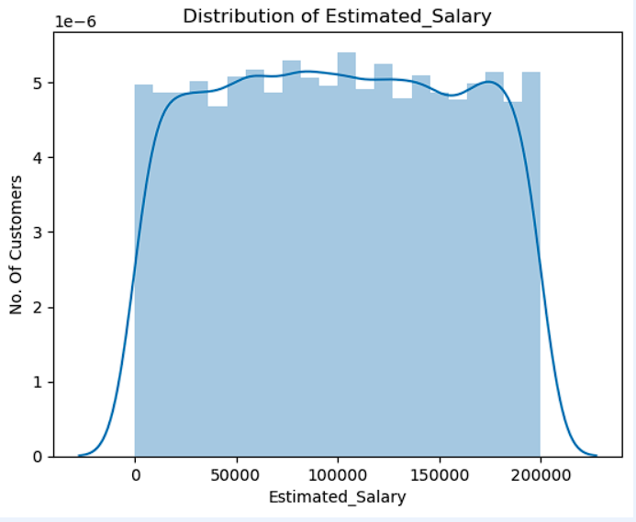
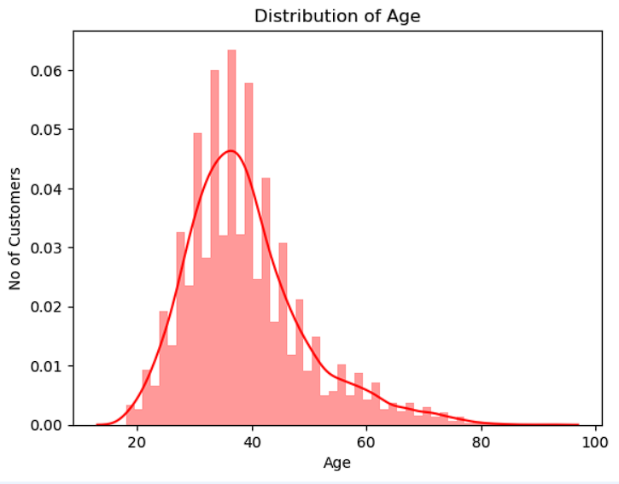
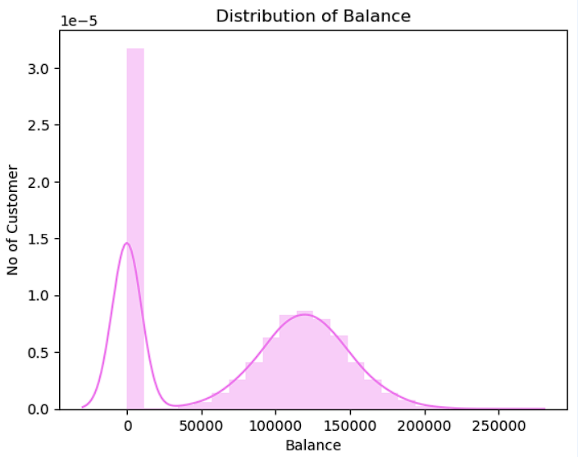
Distribution of Salary, Age, Balance
The count of customer between the age of 30 & 50 is higher
The No. of customer with balance between 100000 & 150000 is higher.

Slide 6
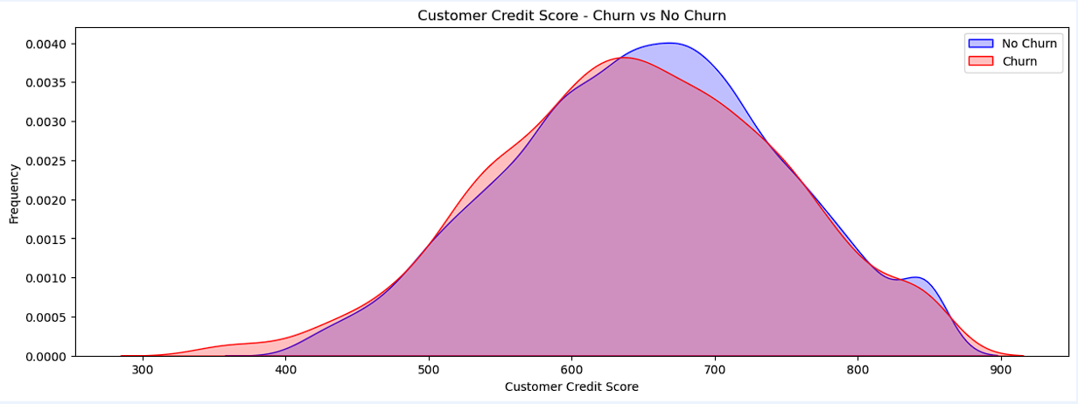
Not much difference

Slide 7
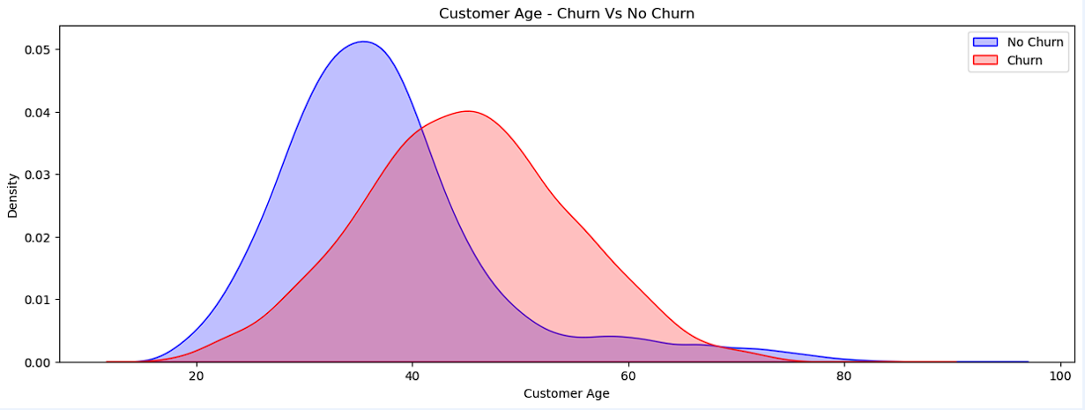
People around the age of 35 to 55 have churned

Slide 8
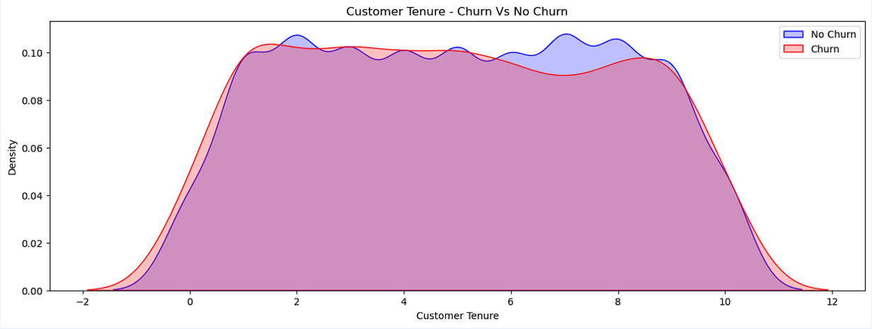
Not much difference

Slide 9
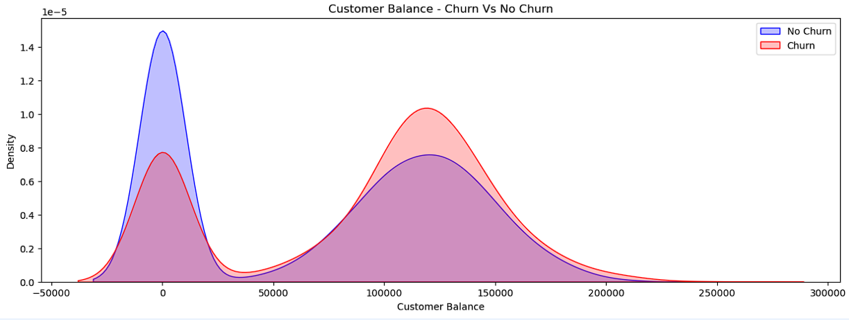
Customer with higher amount of balance have churned more

Slide 10
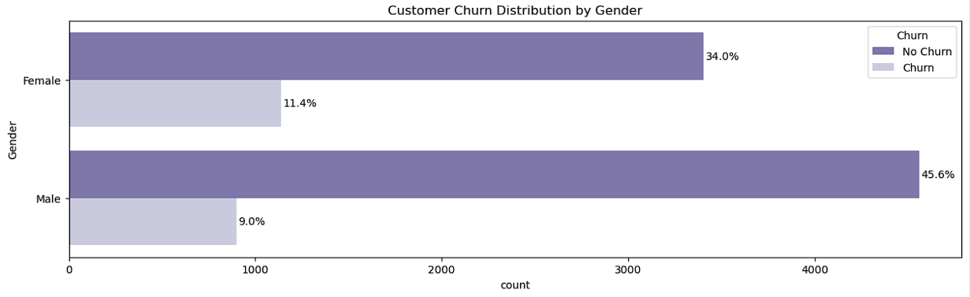
Not much difference

Slide 11
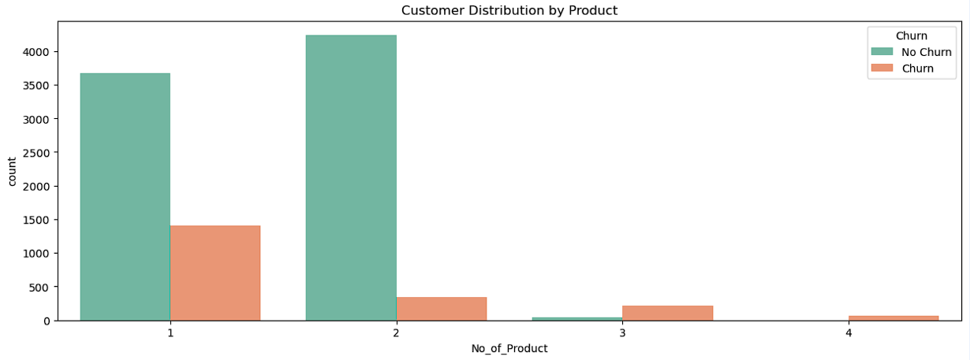
Customer Distribution of Products

Slide 12
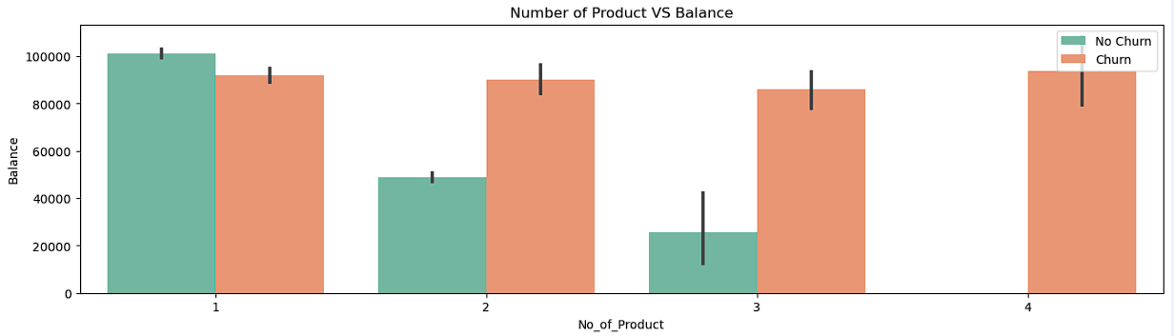
Customers have Churned more from product no. 3 & 4.

Slide 13
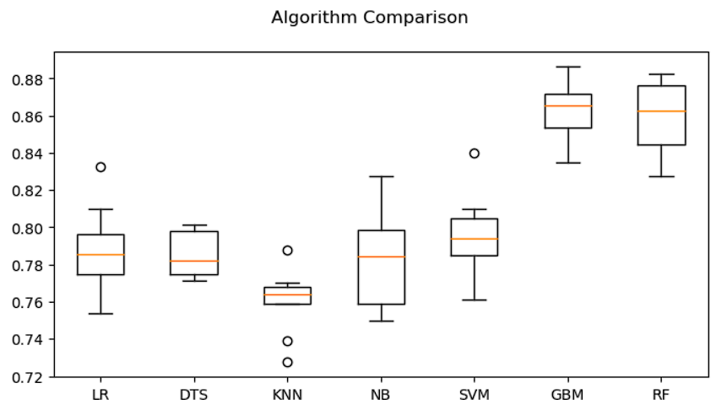
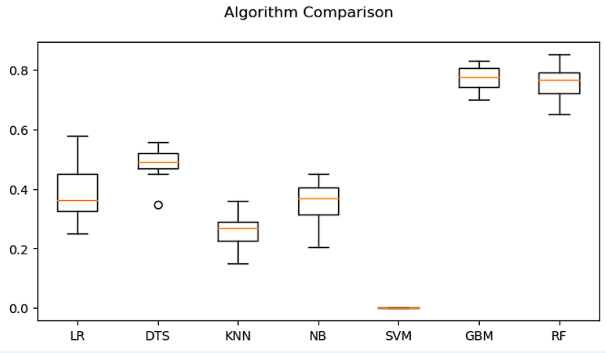
Model Performance
Before performing SMOTE
GBM = 86%
RF = 85%
After performing SMOTE
GBM = 86%
RF = 85%

Slide 14
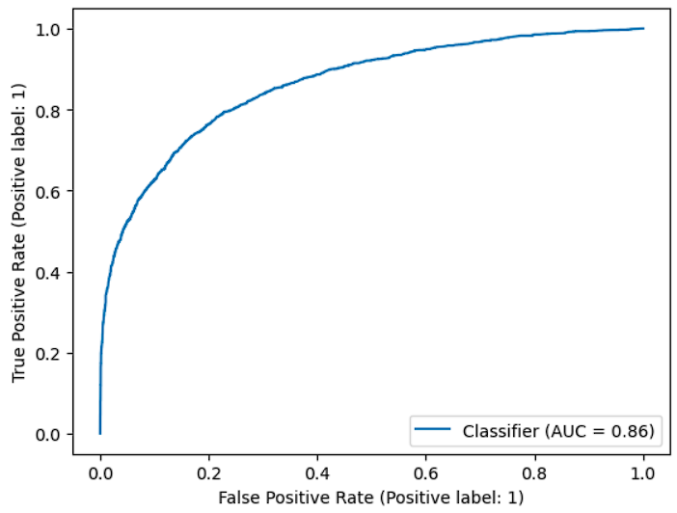
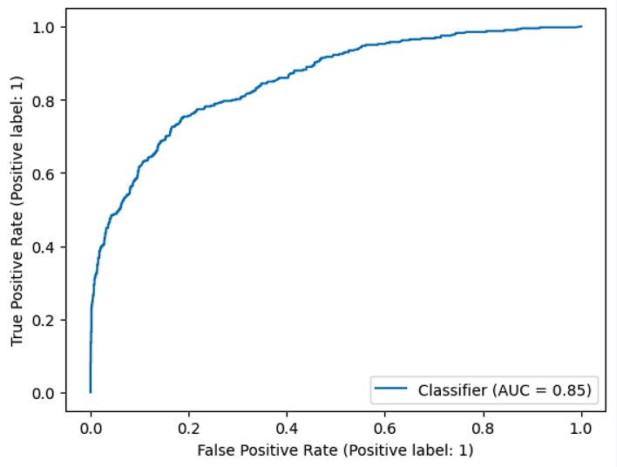
Train ROC-AUC
Test ROC-AUC
ROC-AUC score for train & test are 86 & 85 respectively

Slide 15
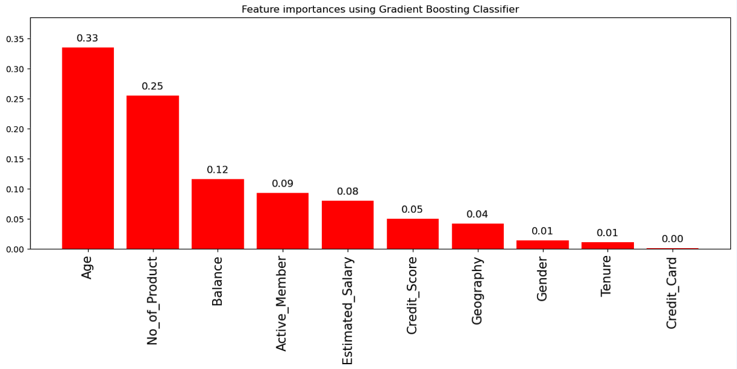

Slide 16
Summary
Customer Age, No of products, & Balance are critical factors influencing churn.
Accuracy of the model with Gradient Boost Classifier is 86%

Slide 17
Thank you!
ANY QUESTIONS?

